Slide 1
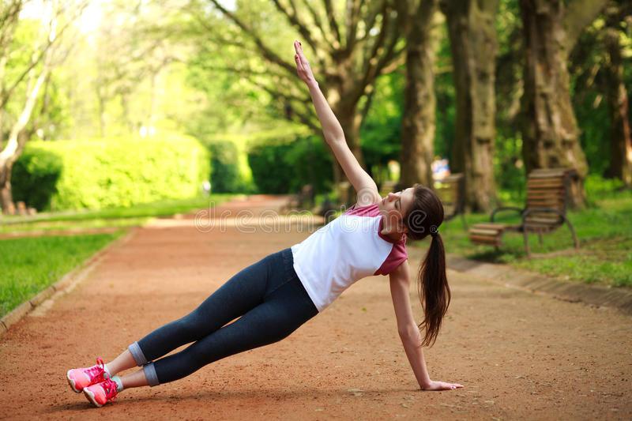
Heal Yourself-Keep Fit Yourself

Slide 2
TEAM MEMBERS:
Sai Chandana.Batchu -171FA04191
Raja Rajeswari.Eluru-171FA04199
Praneetha.Vempati-171FA04187

Slide 3
ABSTRACT:
Recent studies suggest that about 6 out of 10 users have installed a fitness tracking application on their Smartphone . Nevertheless, more than 59% of adults do not engage in sufficient daily physical activity and much remains unknown with regard to the effectiveness of mobile applications.
By adopting this Theory , we have tested whether the use of fitness app could positively influence people's health behaviour or not.
So our project provide their users with different features: Activity tracking, motivation to keep going, socializing , diet and nutrition tips , workout and exercises.

Slide 4
INTRODUCTION:
A fitness app is an application that can be downloaded on any mobile device and used anywhere to get fit.
As of 2015, the number of health-related apps released on the two leading platforms , Iphone operating system (iOS) and Android, had reached more than 1,65,000.
Apps can perform various functions such as allowing users to set fitness goals, tracking caloric intake, gathering workout ideas, and sharing progress on social media to facilitate healthy behavior change.
They can be used as a platform to promote healthy behavior change with personalized workouts, fitness advice and nutrition plans.

Slide 5
CONT....
Through using gamification elements and creating competition among friends and family, fitness apps can help incentive users to be more motivated.
Running and workout apps allow users to run or work out to music in the form of that can be personalized based on the user's steps per minute, heart rate or ideal cadence thus boosting and enhancing performance during exercise.
Fitness apps can work in conjunction with wearable devices to synchronize their health data to third-party devices for easier accessibility.

Slide 6
REQURIMENTS:
Requriments are classified into 2 types namely :
1.Software Requriments
2.Hardware Requriments
SOFTWARE REQURIMENTS:
1. Net beans 2. Mysql 3. Mysql drivers 4. Html,Css,Javascript
HARDWARE REQURIMENTS:
1. Memory-(6.0GB(8GBif using local Mysql))
2.Processor Type-(64 bit)
3.Processor Speed ,Harddisk space

Slide 7
SET OF INPUTS :
These are the set of inputs that are taken from the user and we are suppose to develop it.
And the following are the basic inputs :
1.Register &login
2.Choose workout plan
3.Calculating steps
4.Health tips
5. Medico
6.A re you a positive or negative thinker
7.Tips to De-Stress
8. Statistical graphs
9.Keeping Challenges and Badges

Slide 8
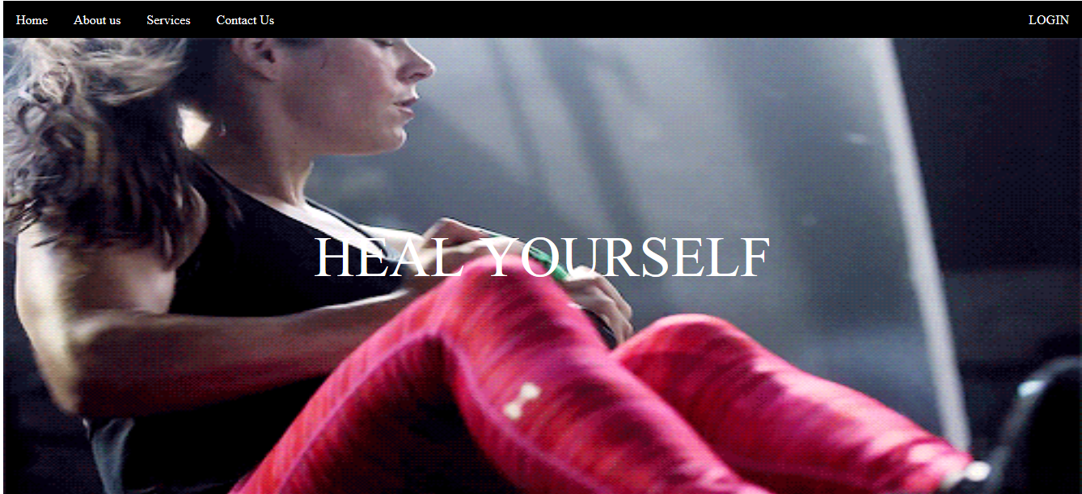
OUTPUT DIAGRAMS:

Slide 9
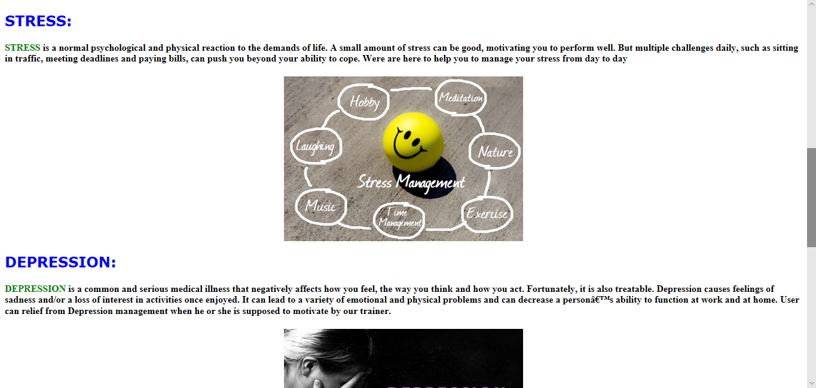

Slide 10
SAMPLE WEBSITES:
The following are the some of the sample websites that we are going to follow and these are the some of the best reference websites.
Those are :
1.12 Minute Athlete
2.On The Regimen
3.Summer Tomato
4.Girls Gone Strong
5.Fat Burning Man

Slide 11
